Slide 1
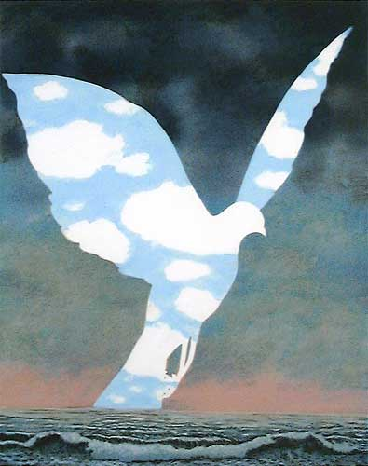
Surrealism
Originally a literary movement, it explored dread, the unconscious, the element of chance and multiple levels of reality.
-More than real
-Better than real
What was happening in the world around this time??
-World War I (1914-1918)
-The science and technology that many thought would bring a better world had gone horrible wrong. So much death and destruction
-Sigmund Freud
-Introduced the public to the notion of the unconscious mind

Slide 2
Salvador Dali

Slide 5
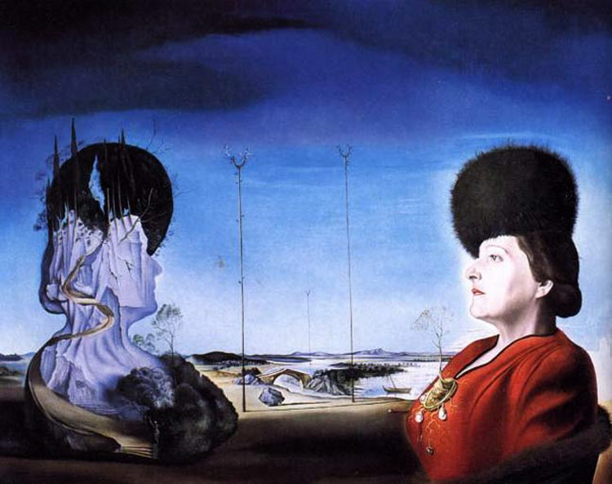

Slide 12
Rene Magritte

Slide 19
Frida Kahlo

Slide 24
M.C. Escher

Slide 30
Random Surreal Images

Slide 37
What do you need to include?
-A landscape or setting that depicts a deep space
-A main subject, human, animal or hybrid
-Show depth using linear and atmospheric perspective, overlapping forms, reduction in size of objects and placement on the page
-Show an obvious foreground, middle ground, background
-Show a variety of textures
-Have a clear and consistent light source

