Slide 1
The Principles of Design:
How an artist organizes the Elements of Art to make a successful work of art.

Slide 2
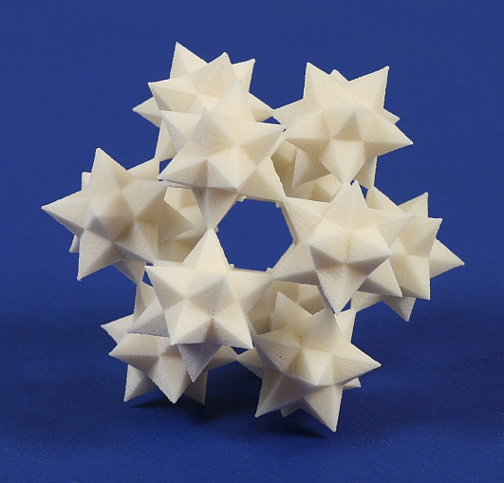
1. UNITY
Unity is a measure of how the Elements of Art seem to fit and belong together.
A unified sculpture seems complete, with nothing that looks out of place.

Slide 3
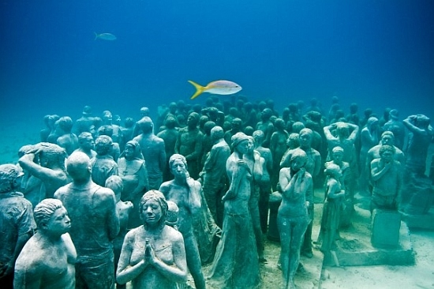
Unity shown through use of _______

Slide 4
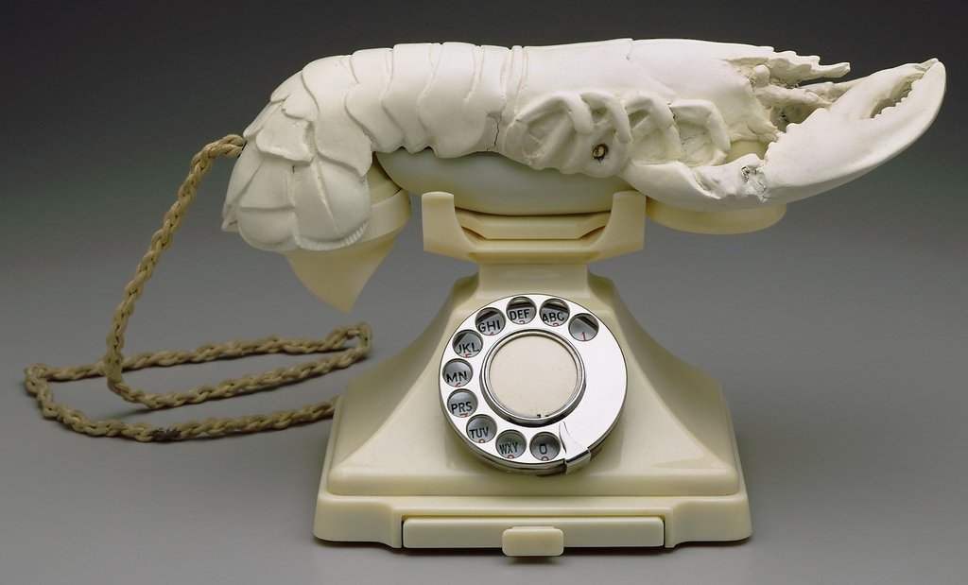
2. VARIETY
Variety comes from combining one or more elements of art in different ways to create diversity and interest.

Slide 5
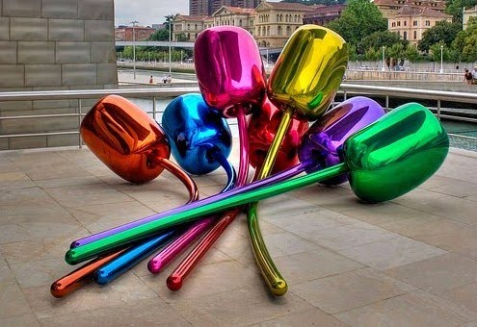
Variety shown through use of _______

Slide 6
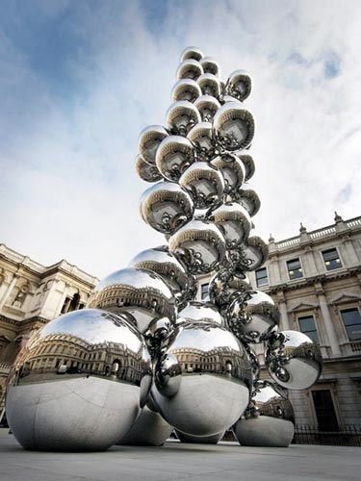
3. REPETITION
Repetition is created when one or more Elements of Art are repeated in artwork.
Repetition helps create unity in a sculpture

Slide 7
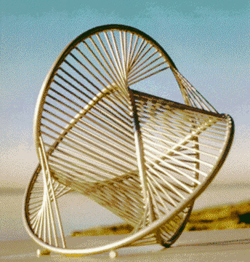
Repetition shown through use of _______

Slide 8
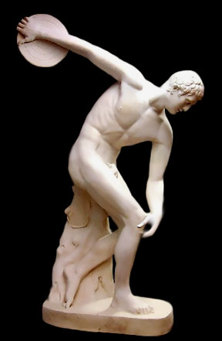
4. PROPORTION
Proportion has to do with the size of one element to another in a sculpture.
Altered proportion - A technique used by an artist to change the size relationship of forms in an artwork.

Slide 9
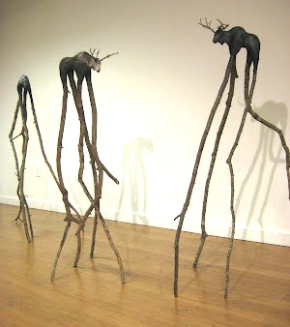
Proportion shown in _______
Altered proportion shown in _______

Slide 10
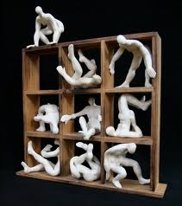
5. EMPHASIS
Emphasis occurs any time an Element of Art stands out, in order to draw the viewer's eye there first.

Slide 11
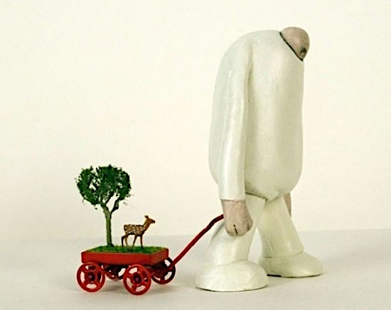
Emphasis shown through use of _______

Slide 12
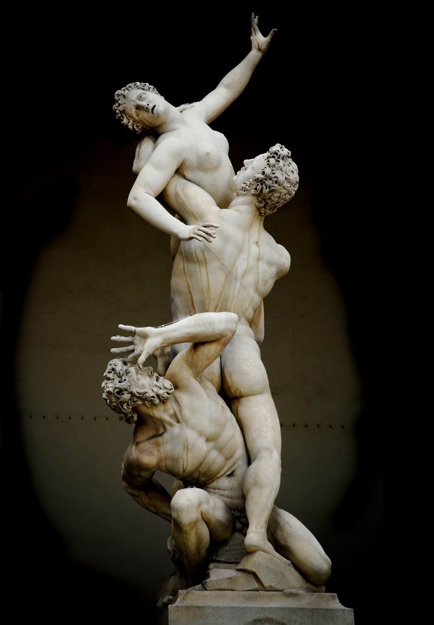
6. MOVEMENT
Movement is created by using Elements of Art to give the feeling of motion and to guide the viewer's eyes throughout the artwork.

Slide 13
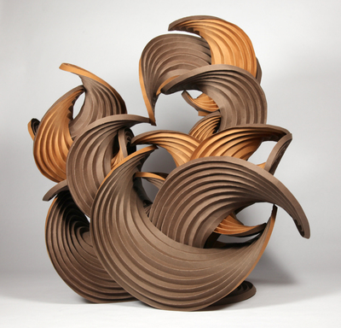
Movement shown through use of _______

Slide 14
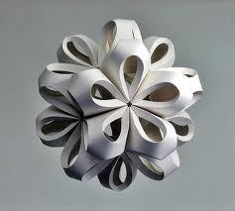
7. BALANCE
Balance is arranging elements so that no one part of a work overpowers, or seems visually heavier, than any other part.

Slide 15
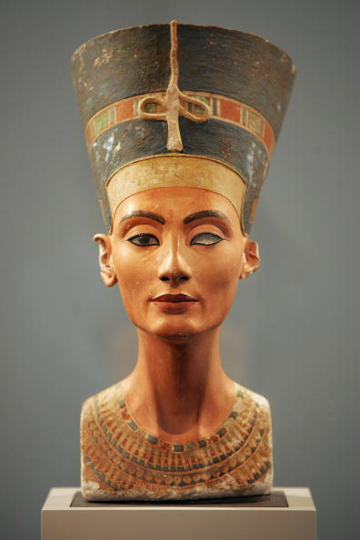
Symmetrical balance
Symmetrical (or formal) balance is the most stable, in a visual sense.

Slide 16
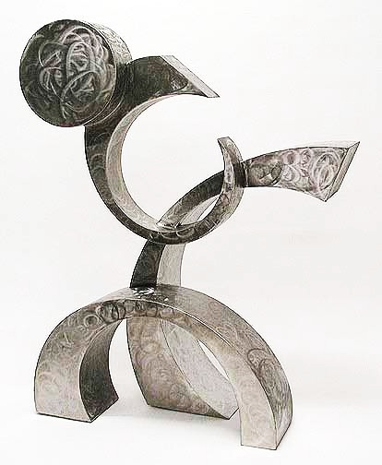
Asymmetrical balance
asymmetrical (or informal) balance occurs when elements are placed unevenly in a piece, but they still work together to produce harmony overall.

Slide 17
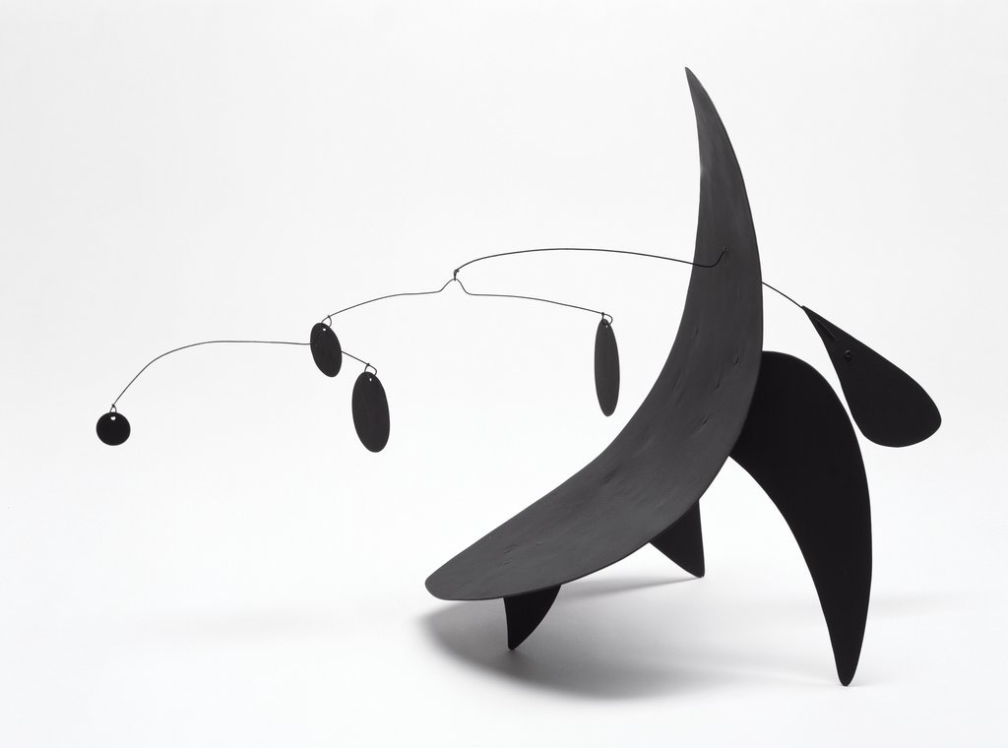
_______ balance shown in _______

