Slide 1
Play Poster
Cabaret

Slide 2
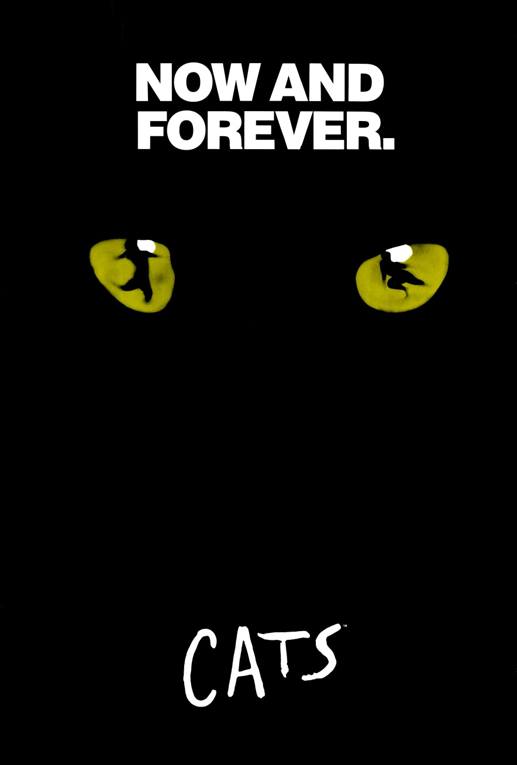

Slide 3
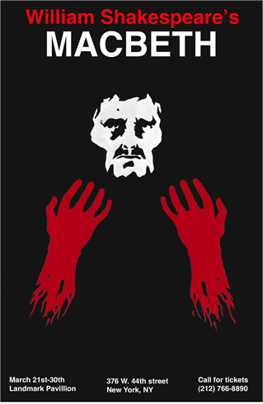

Slide 4
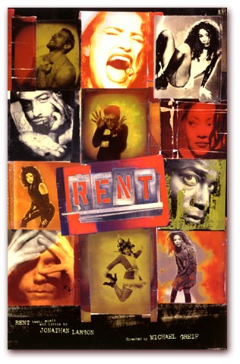
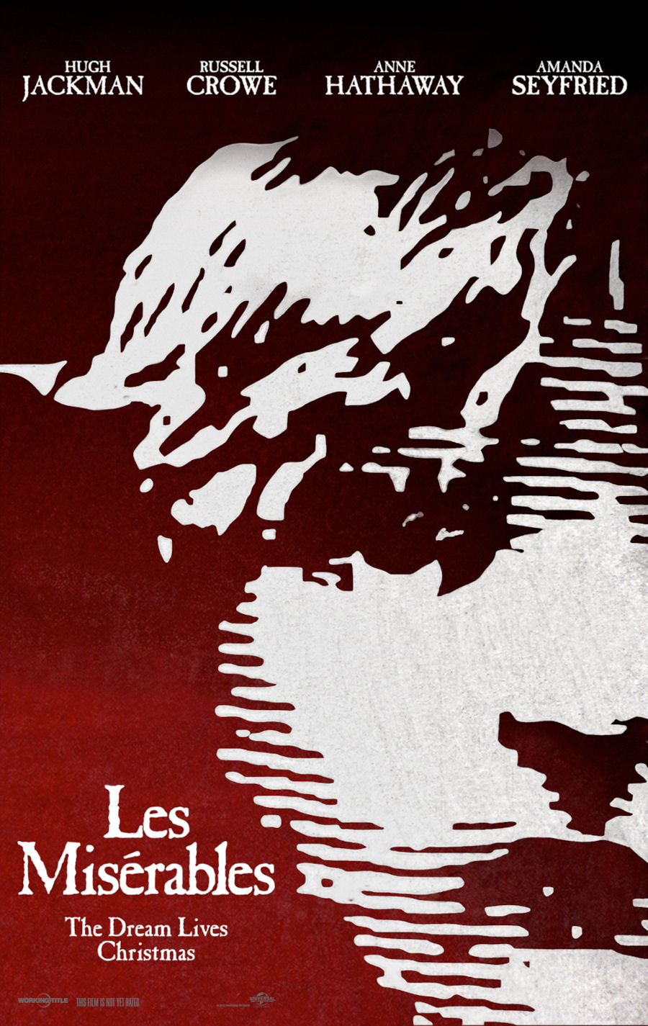

Slide 5
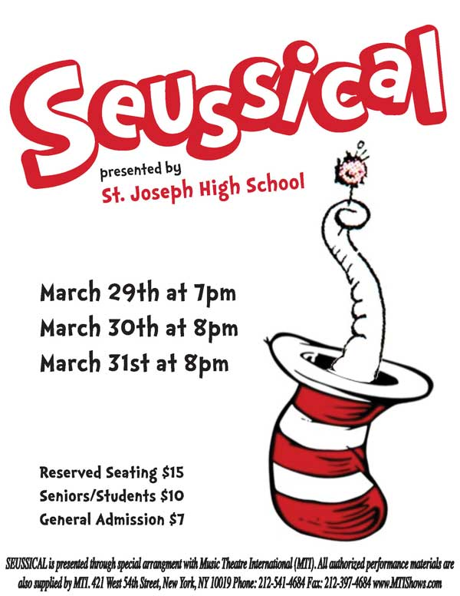

Slide 7
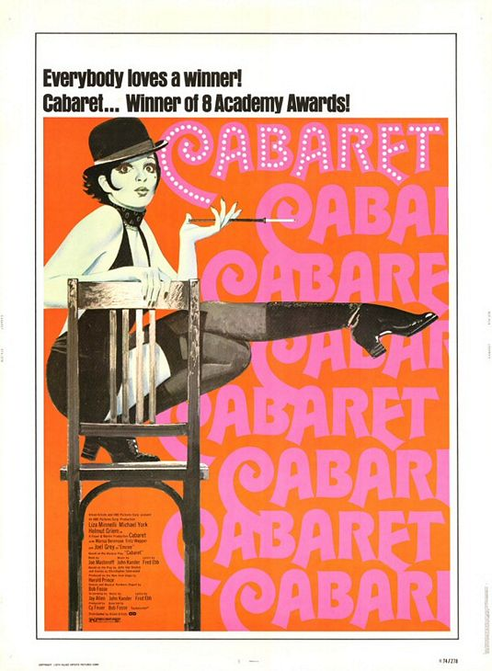

Slide 9
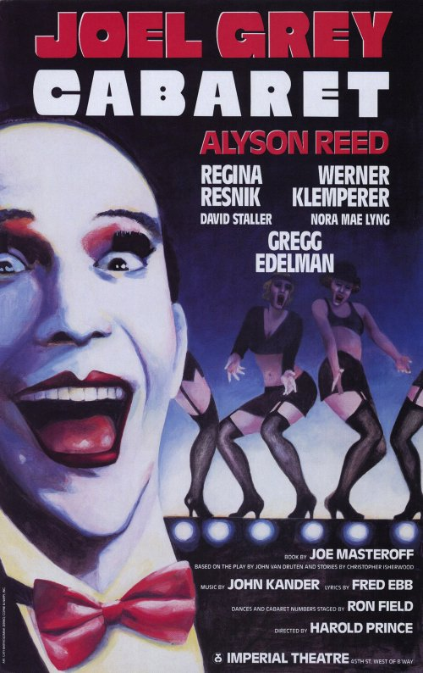

Slide 11
Items that HAVE to be on the POSTER
Cabaret
May 16th (Student Matinee)
May 17th &18th 8pm
-Table Seating $25 – (Food & Drinks Served)
General Seating $15 Suggested Donation
-Oakwood Friends School Music Program
-Lane Auditorium
1998 Version
Book by Joe Masteroff
Music by John Kander
Lyrics by Fred Ebb
With Permission from Tams-Witmark Music Library, Inc.
-----------------
Theme : Dark, Smoky, Blacks & Reds
Look up Cabarets from that time period (historical)
**NO SWASTIKA

