Slide 1
Packaging Design
Got Milk?

Slide 2
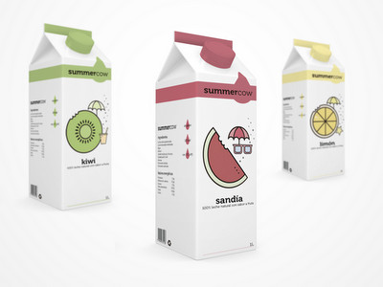
3 different designs for 1 product

Slide 3
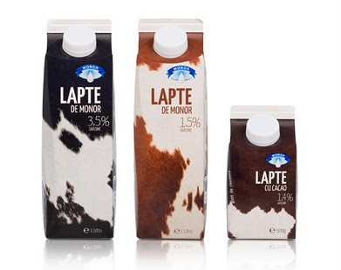

Slide 4
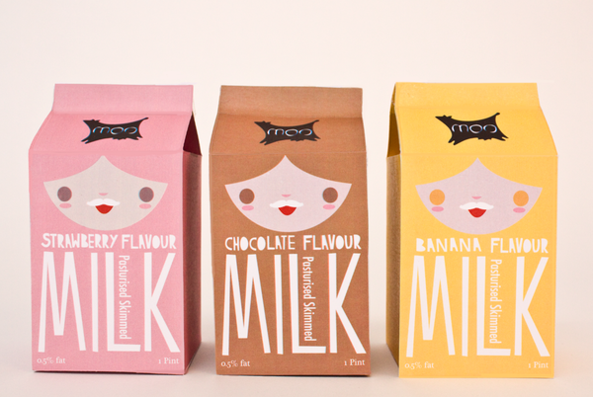
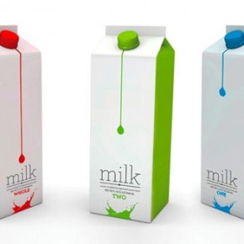
All Designs should be relate to each other

Slide 5
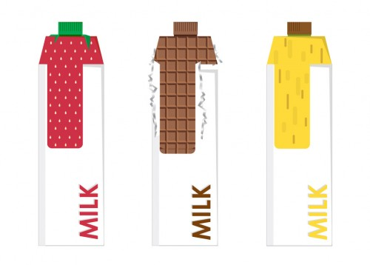

Slide 6
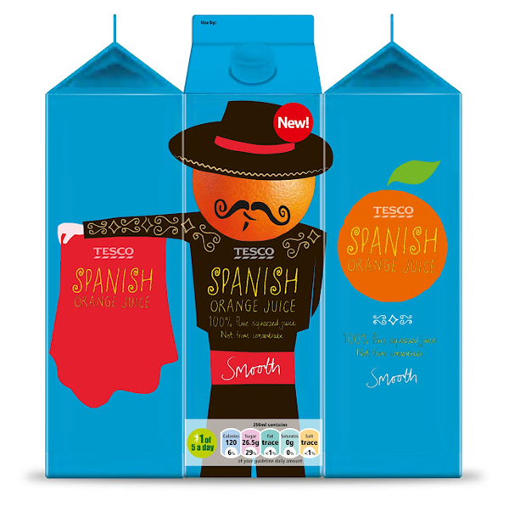
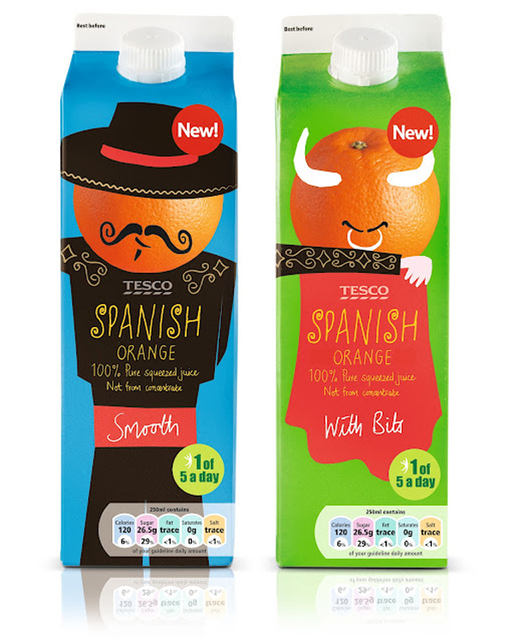
Juice Packaging

Slide 7
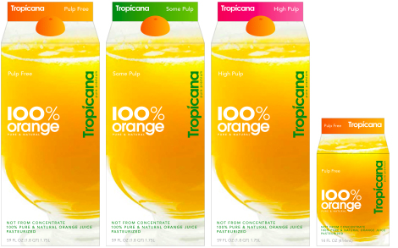

Slide 8
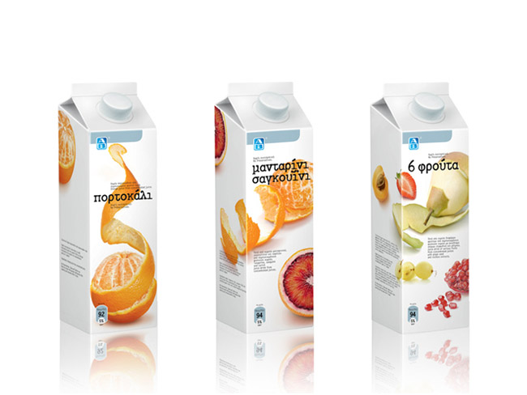

Slide 9
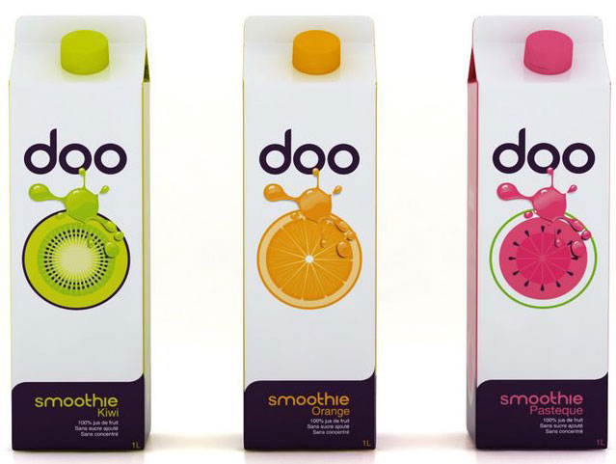

Slide 10
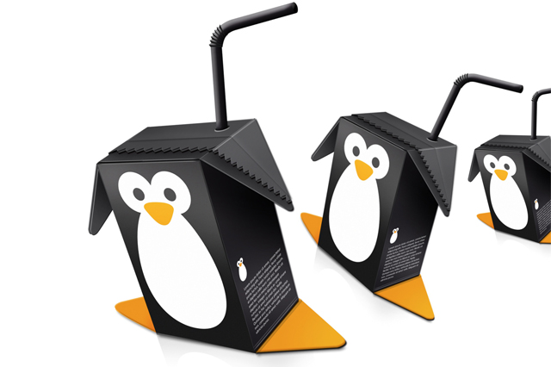
Other creative packaging…

Slide 11
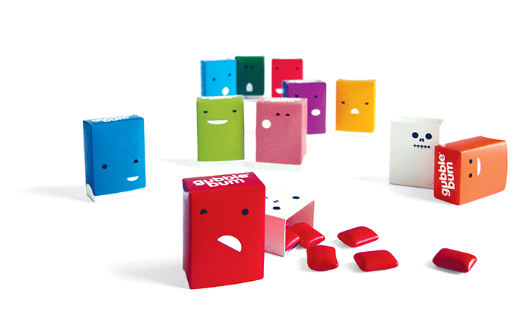

Slide 12
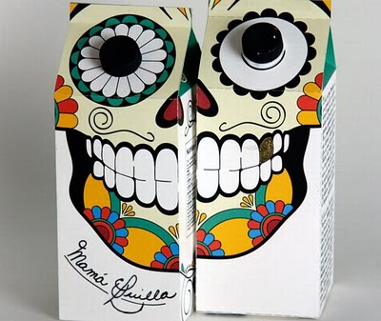

Slide 13
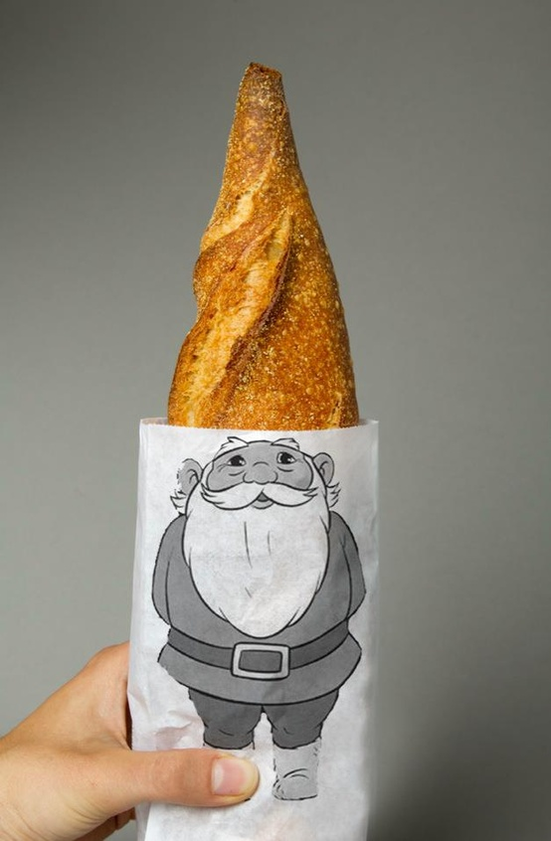

Slide 14
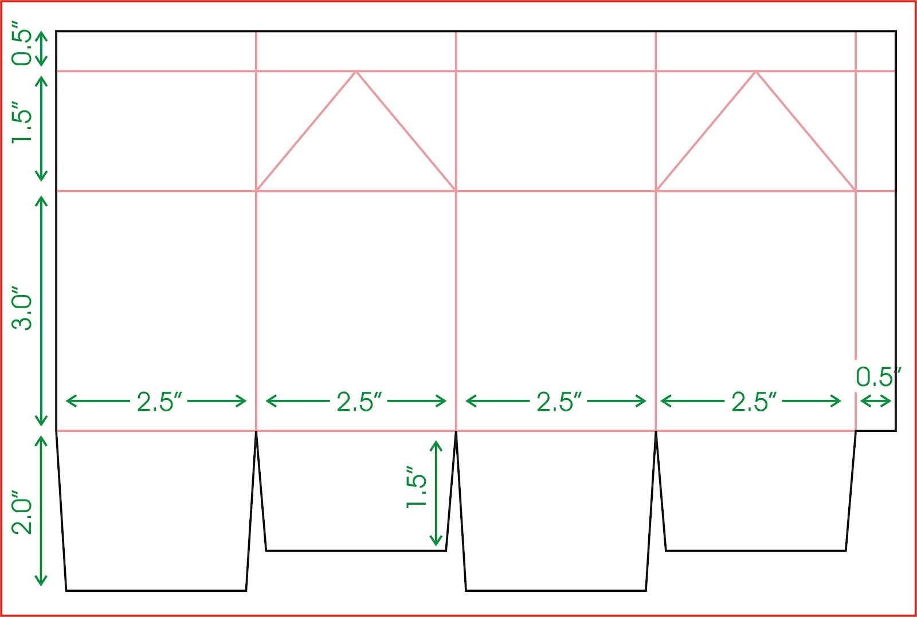
Milk Carton Dimension

Slide 15
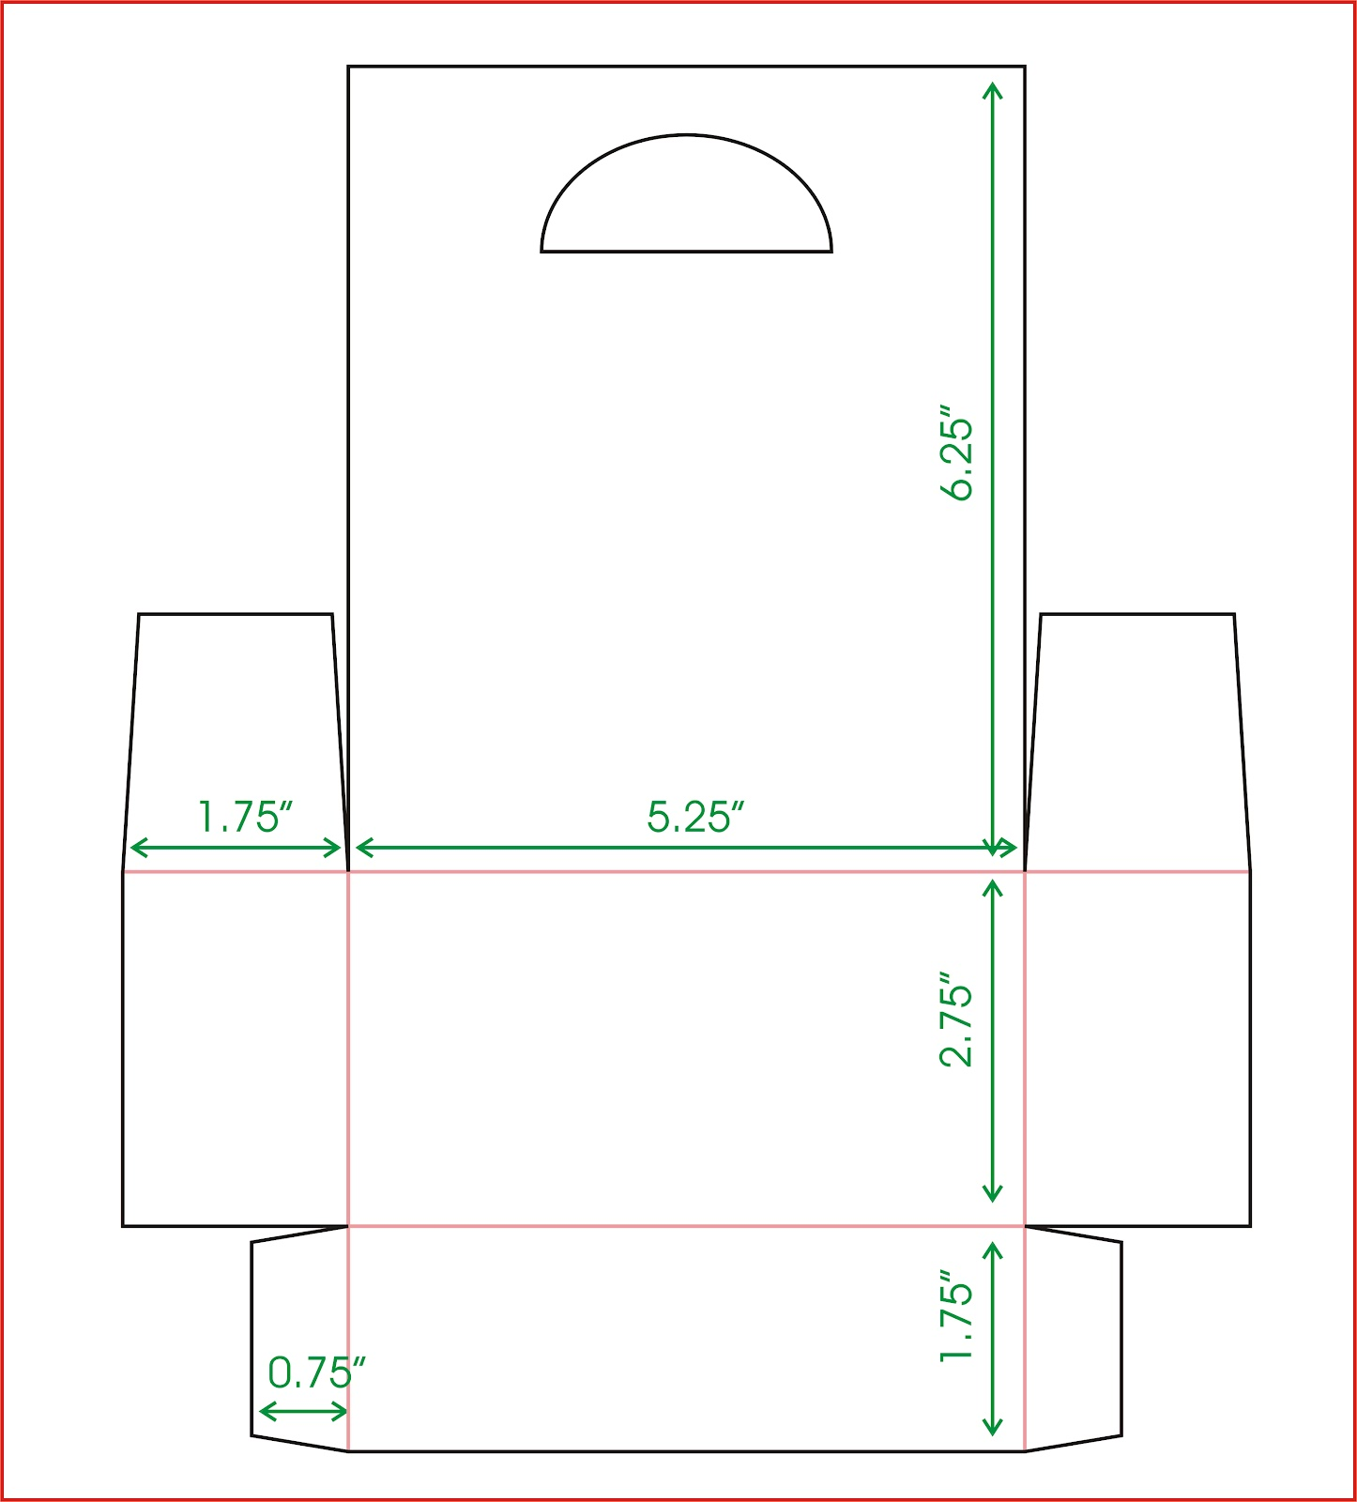
Carton Holder

Slide 16
-Create a package design that would fit a milk carton box.
-It does not have to be for MILK, but for any other item that you think
would suit this style box.
-Ideas might include: Milk, Orange Juice, Cranberry juice,
Coffee in a box, Chocolate bites…
-Be creative! Think outside the ‘box’
-Must include some text. Name of product, company, information
about product. If it is a food item, somewhere on the box it should
have the health information
-Have 3 relatable designs for one product. Reference slide #3,4,5
All sides of the box must be used !

