Slide 1
Marketing & Advertising Who are you selling to?
Graphic Design

Slide 3
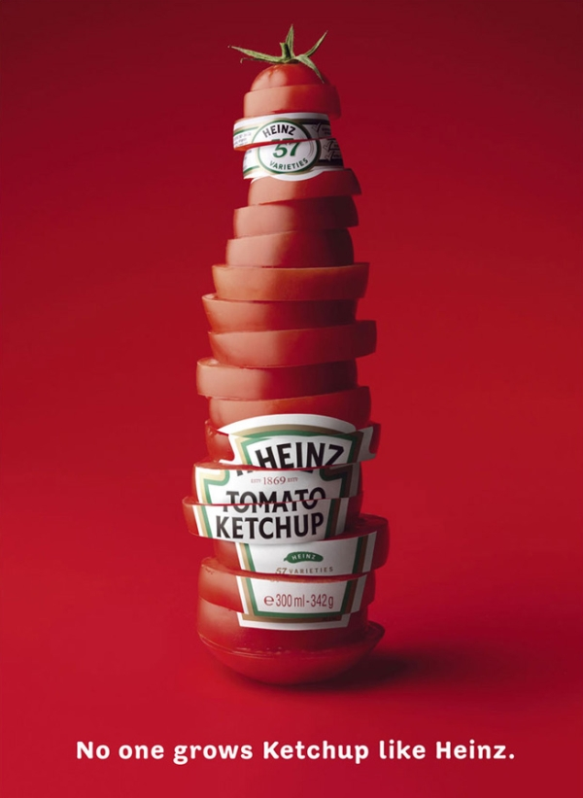

Slide 8
What will you advertise?
Who is your audience?
What color schemes will you use?
Written information needed?
Where will the product go
How will you compose the images?
Pick your product & make a story board

Slide 9
Split into 2 teams
Team #1
Hint Water
http://www.drinkhint.com/products/
Do your research
Team #2
Powerade
http://www.us.powerade.com/
Do your research

